Slide 1
Week of Prayer for Christian Unity
2027

Slide 2
Hymn
Do Not Be Afraid

Slide 3
Insert the words of your chosen hymn …
Week of Prayer for Christian Unity

Slide 4
Insert the words of your chosen hymn …
Do Not Be Afraid

Slide 5
Peace be with you.
And also with you.
Christ is among us.
He is and always will be.
Week of Prayer for Christian Unity

Slide 6
Introduction to the Service
Do Not Be Afraid

Slide 7
Opening Prayer
Week of Prayer for Christian Unity

Slide 8
Blessed are you Lord God of all creation.
Blessed are you Jesus Christ, the Way, the Truth and the Life.
Blessed are you Holy Spirit,
the Lord and giver of life.
Do Not Be Afraid

Slide 9
Blessed are you, O Holy Trinity.
Blessed are you in your saints.
Blessed be this gathering as we come together in your divine presence
to celebrate in the name
of the Father, Son and Holy Spirit.
Amen.
Week of Prayer for Christian Unity

Slide 10
Hymn
Do Not Be Afraid

Slide 11
Insert the words of your chosen hymn …
Week of Prayer for Christian Unity

Slide 12
Insert the words of your chosen hymn …
Do Not Be Afraid

Slide 13
Prayer of Thanksgiving and Lament
Week of Prayer for Christian Unity

Slide 14
We give thanks
that we are called to be one,
but we lament that
we often betray our unity.
Christ our Shepherd,
unite us as one flock.
Do Not Be Afraid

Slide 15
We give thanks
that we have one shepherd,
but we lament that we often fail
to recognise others as his own.
Christ our Shepherd,
unite us as one flock.
Week of Prayer for Christian Unity

Slide 16
We give thanks that
we have been baptized into one faith,
but we lament that
we often act otherwise.
Christ our Shepherd,
unite us as one flock.
Week of Prayer for Christian Unity

Slide 17
We give thanks that we have one hope,
but we lament that
we often exclude others from it
Christ our Shepherd,
unite us as one flock.
Do Not Be Afraid

Slide 18
We give thanks for the love
that unites us in mutual care,
but we lament that
we often care chiefly for ourselves
Christ our Shepherd,
unite us as one flock.
Do Not Be Afraid

Slide 19
As many as have been baptized
into Christ have put on Christ.
Alleluia!
The peace of the Lord be always with you.
And also with you.
Week of Prayer for Christian Unity

Slide 20
Reading from Ezekiel 34. 15-22
Do Not Be Afraid

Slide 21
Psalm 23
Week of Prayer for Christian Unity

Slide 22
Reading from Luke 12. 22-34
Do Not Be Afraid

Slide 23
Reading the Gospel of Jesus Christ according to Luke 12. 22-34
Glory to you, Lord our God.
Week of Prayer for Christian Unity

Slide 24
Sermon
Do Not Be Afraid

Slide 25
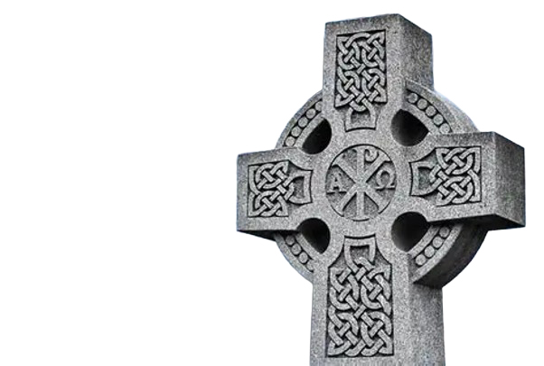
Symbolic Action
Week of Prayer for Christian Unity

Slide 26
Confession of Faith
Do Not Be Afraid

Slide 27
We believe in one God,
the Father, the Almighty,
maker of heaven and earth,
of all that is, seen and unseen.
We believe in one Lord, Jesus Christ,
the only Son of God, eternally begotten of the Father,
Week of Prayer for Christian Unity

Slide 28
Light from Light,
true God from true God,
begotten, not made;
of one Being with the Father.
Through him all things were made.
For us all, and for our salvation
he came down from heaven;
Do Not Be Afraid

Slide 29
and was incarnate of the Holy Spirit and the virgin Mary,
and was made human.
For our sake he was crucified under Pontius Pilate;
he suffered death and was buried.
Week of Prayer for Christian Unity

Slide 30
On the third day he rose from
the dead in accordance
with the scriptures.
He ascended to heaven and is seated at the right hand
of the Father.
Do Not Be Afraid

Slide 31
He will come again in glory to judge the living and the dead
and his kingdom will have no end.
We believe in the Holy Spirit,
the Lord, the giver of life,
who proceeds from the Father.
Week of Prayer for Christian Unity

Slide 32
Who, with the Father and the Son, is worshipped and glorified,
who has spoken
through the Prophets.
We believe in one, holy, catholic and apostolic Church.
Do Not Be Afraid

Slide 33
We confess one baptism
for the forgiveness of sins.
We look forward to the resurrection of the dead,
and to life in the age to come. Amen.
Week of Prayer for Christian Unity

Slide 34
Prayers of Intercession
In your mercy
Hear Our Prayer
Do Not Be Afraid

Slide 35
Hymn
Week of Prayer for Christian Unity

Slide 36
Insert the words of your chosen hymn …
Do Not Be Afraid

Slide 37
Insert the words of your chosen hymn …
Week of Prayer for Christian Unity

Slide 38
Concluding Prayer and The Blessing
Do Not Be Afraid

